Slide 1
L4 Reading & Writing Group #3 Group members: 崔士强 刘轩逸 戴维

Slide 2
Today, we will…
1. Vocabulary Quiz
2. Background info
3. Article Discussion
4. Q&A

Slide 3
1
Vocabulary Quiz

Slide 4
Write the English word according to the description.
Scoot First, Ask Questions Later
The state of being crowded and full of traffic.
To exist in great numbers or quantities.
A technology that draws a virtual line around a physical area so that a signal can be sent to a mobile electronic device such as a phone inside this line or when this line is crossed.
A group of planes, buses, taxis, etc. owned by the same organization.

Slide 5
Vocab Quiz Answers:
congestion
abound
geofencing
fleet

Slide 6
2
Background Info.

Slide 7
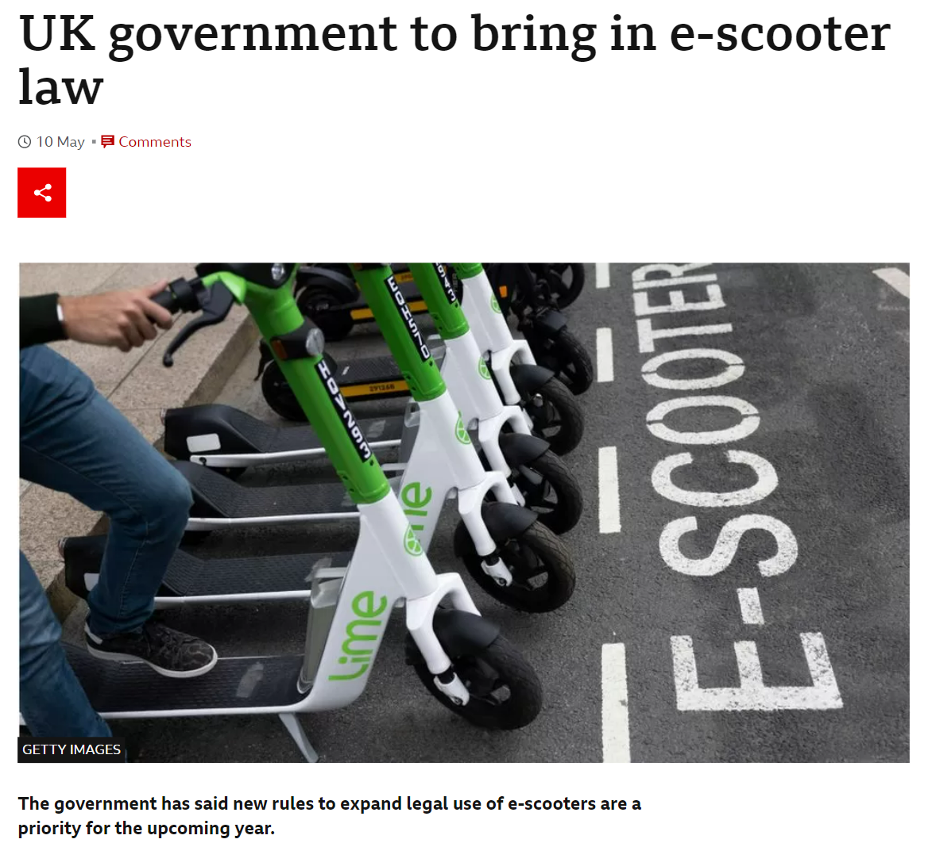
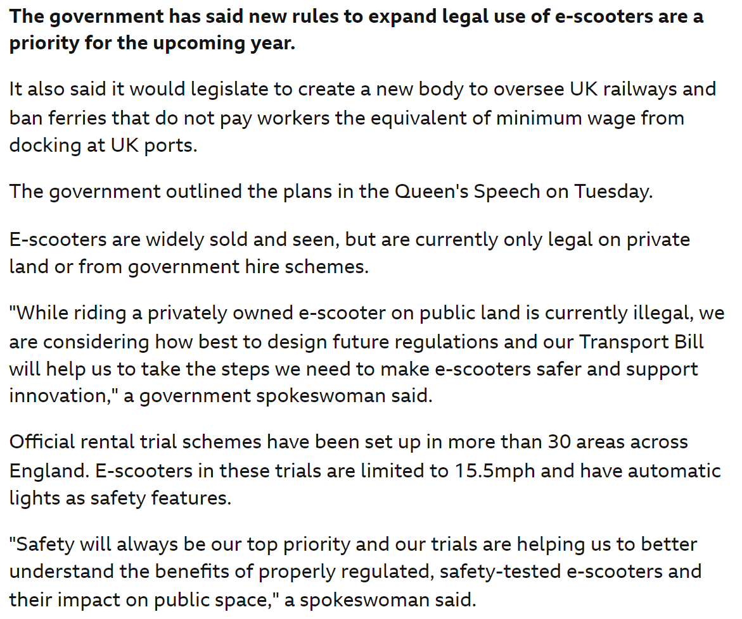
Background info…

Slide 8
Background info…
To support a ‘green’ restart of local travel and help mitigate reduced public transport capacity, in July 2020, the Department for Transport (DfT) made regulations allowing trials of rental e-scooters to be fast tracked and expanded.
This guidance is intended to inform local authorities and e-scooter operators about trial requirements.

Slide 9
Background info…
The trials are now live in 31 regions across England. A comprehensive monitoring and evaluation programme is also underway to assess the safety of e-scooters and their wider impacts.
All trial proposals need to come from local authorities. The deadline for local authorities to express an interest in taking part in the trials was 31 August 2020. E-scooter operators can take part in the trials only through a local authority procurement exercise and with necessary permissions from DfT.

Slide 10
3
Article Discussion

Slide 11
Question 1
What is the author’s purpose to start with the example of Michael Dewey ?
Answer
1.to raise readers’ interest.
2.to show the advantages of e-scooters: money-saving and convenient.
3.to demonstrate a new trend: people are beginning to accept e-scooters as a replacement for cars when going on a relatively short journey.

Slide 12
Question 2
Why does British government take experiment on the e-scooters?
Answer
1. To be more environmental-friendly and to cut down the emission of carbon-dioxide.
2. The availability of e-scooters needs trials to check out.

Slide 13
Question 3
What are the major concerns of e-scooters?
Answer
1 Safety (drug dealers may use them to evade the police, e-scooters may cause more traffic accidents)
2 E-scooters may not be as green as people think.

Slide 14
Question 4
According to the passage, what possible measures can be taken to prevent negative impacts of e-scooters?
Answer
1. Improve transport infrastructure(e.g. build good cycle lanes).
2. Set up regulations to force e-scooters to be driven in a particular lane.
3. Use geofencing to restrict e-scooters to certain areas as well as enforcing speed limits.

Slide 15
Question 5
Why does the author say “scoot first, ask questions later”?
Answer
1. Current experiment and research show that the benefits of e-scooters outweigh the drawbacks
2. The problems (congestion, pollution, absence of public transport, etc.) are urgent and need to be solved at once.
So we’d better start using them first and make adjustments afterwards.

Slide 16
Question 6
Open question: In China, there are rental electric bikes, which are favored by a lot of people but are banned in some cities (e.g., Hangzhou). What’s your opinion?
Answer
pro: convenient, cheap, efficient,etc.
con: taking up too much space, may produce waste, hard to manage on a large scale, etc.

Slide 17
4
Q&A

Slide 18
Thanks!

